Slide 1


A Compact, Symmetrical and Efficient Filtered Cathodic Arc Source That Uses All Permanent Magnets
Paul Sathrum
Fluxion Inc.
fluxion-inc.com

Slide 2
The Radial Arc Source
  Magnetic Island Rectilinear Filter
  Tubular Outer Magnet (152mm ø X 152mm long)
  Cylindrical Center Magnet
  Cathode Magnet
  Exit Magnet
  Cathode (70mm ø)
  Housing (Anode)
  MP Blocker
  Baffling
  Exit Aperture

Slide 3
Permanent Magnets versus Coils
Care must be taken to keep plasma from concentrating at the poles.
In development, the magnetic field was easier to refine: the location, size, and shape of permanent magnets were easier to vary. FCA is very sensitive to field shape.
Strong magnetic field: 98mT.
Compact size.
Retains the simplicity of unfiltered arc:
  Can be mounted by one person, connected to a DC welder and triggered on.
  There are no coil power supplies.

Slide 4
Features of the Magnetic Field
Fields from Outer and Inner Magnets combine constructively (98mT)
Center magnet is positioned towards the exit end of the duct
Arc is closely coupled to the filter and strongly magnetized (50mT, 29V)
  promotes efficiency, stability, MP elimination and good erosion
Iron Filings Map (no Exit Magnet)

Slide 5
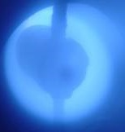
Plasma Around the Center Magnet
Field lines converge above the Cathode, creating a strong field that curves around the Center Magnet, guiding the plasma through the curve and separating macroparticles, which travel in straight lines.

Slide 6
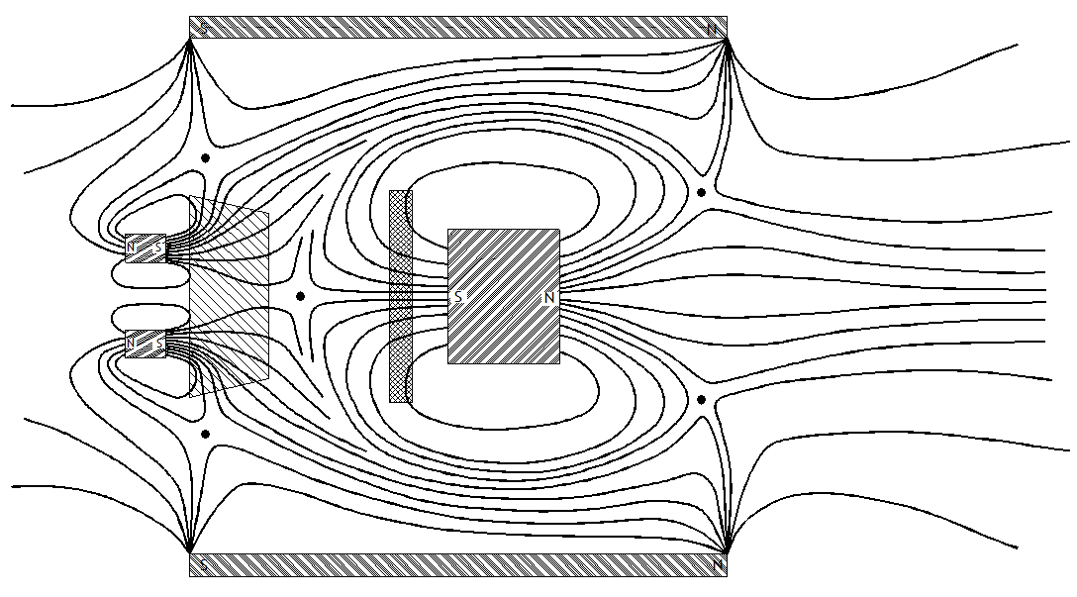
…Features of the Magnetic Field
Plasma follows the field lines from the arc, around the Center Magnet, and through the Exit Null Ring positioned between the poles, avoiding destruction at the poles.
Plasma is then pinched down through the Exit Aperture.
And carried to the Substrate on diverging field lines with a symmetrical distribution.

Slide 7
Effect of the Exit Magnet on the Magnetic Field
Exit Null Ring larger
Field diverges more
No Exit Magnet
With Exit Magnet

Slide 8
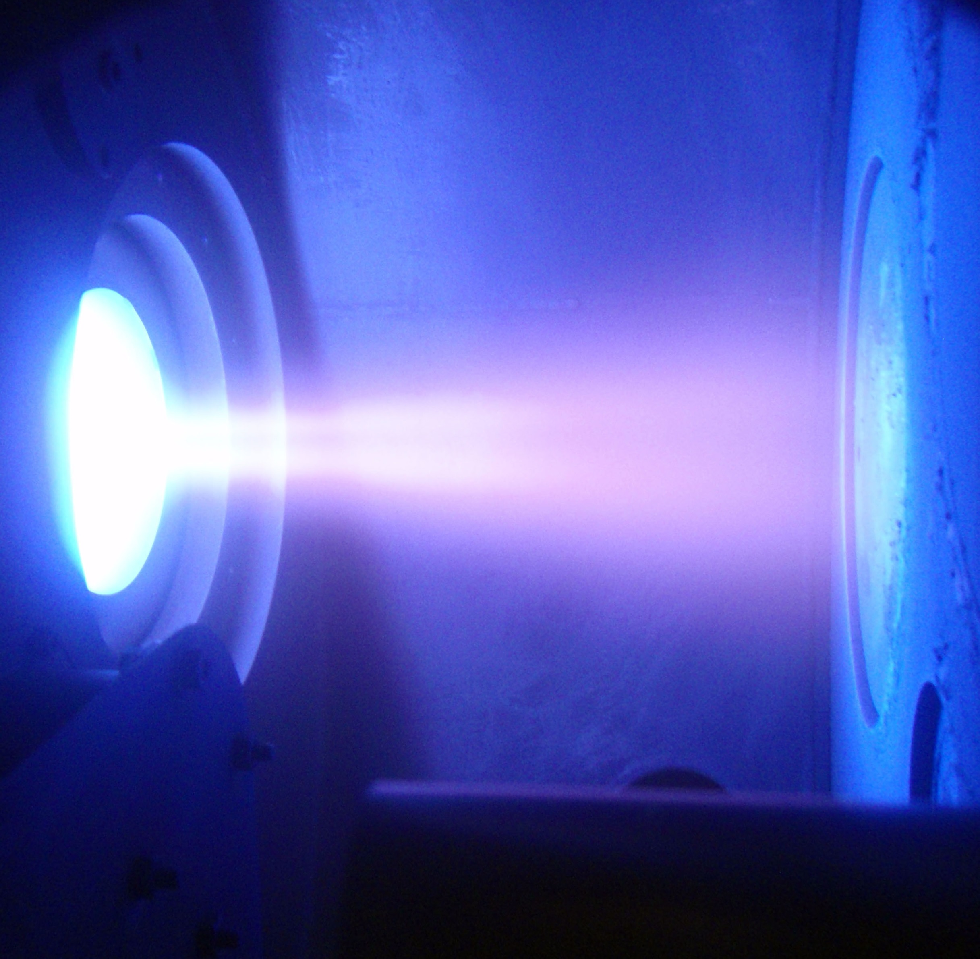
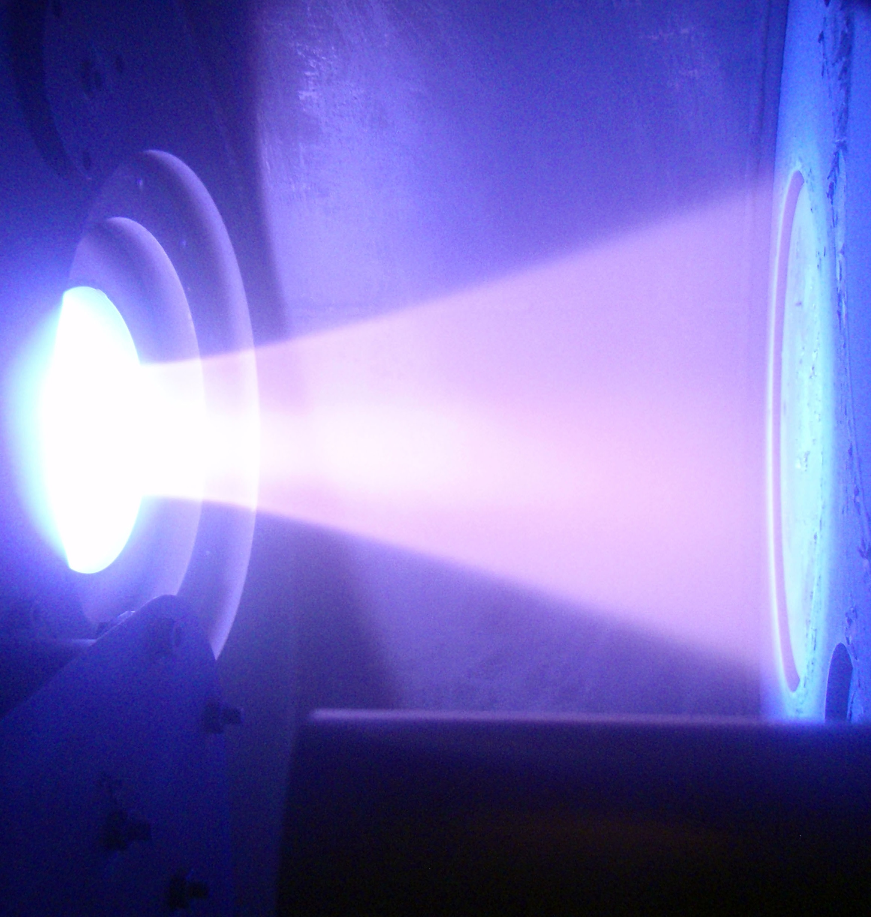
Titanium Plasma Exiting the Filter
No Exit Magnet
With Exit Magnet

Slide 9
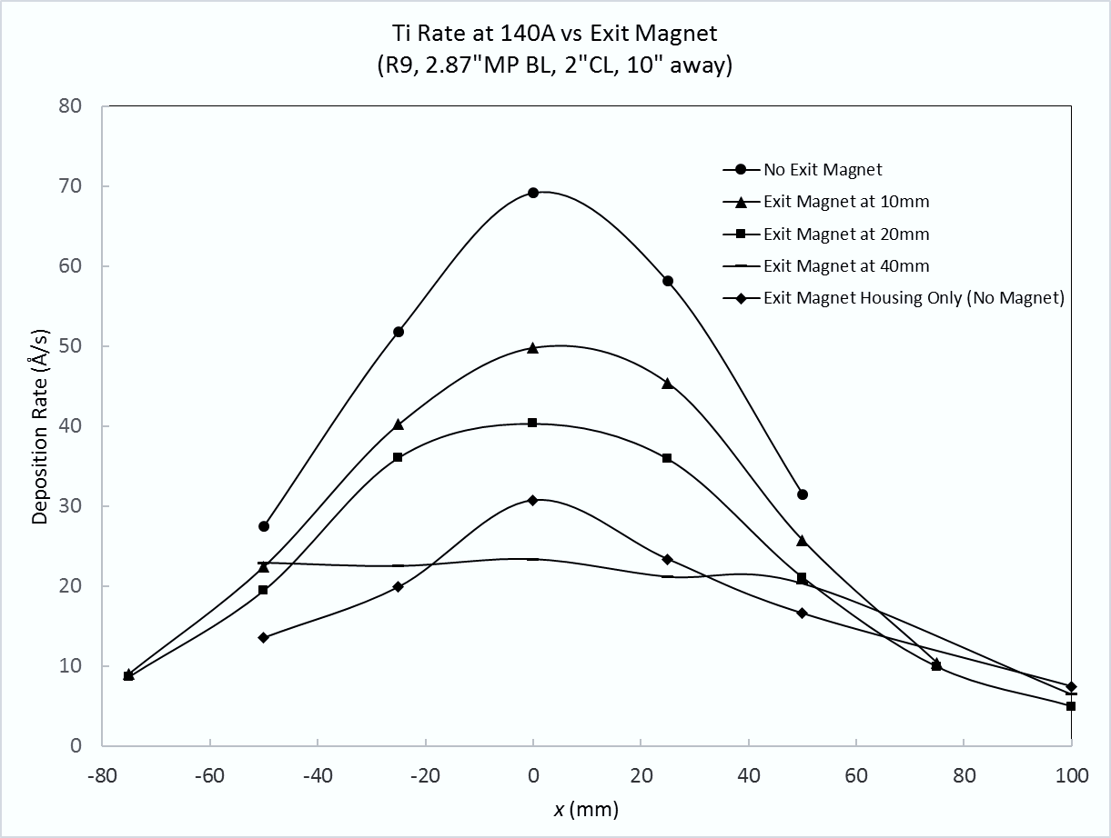
Titanium Rate Distributions with Various Exit Magnet Locations
Stationary uniformity over 110mm with Exit Magnet at 40mm from Center Magnet.

Slide 10
Ion Current On Large Collector was 8.3% of Arc Current
Large 610mm diameter Substrate, biased to -100V Saturation
84A carbon arc current - collected ion current was 7A
8.3% implies high ion transport efficiency (theoretical max is 10%)
  Confidence in this number is not great though (gas ions, blocked anode)
  Preferable to use a small, scanning collecting probe, as is typically used
    But these have their own sources of error
      Have to know ion species distribution to calculate efficiency
Deposition Rate Profiles are Straightforward to Interpret
  Coating volumes can be calculated from the profiles
    Volume = the actual numbers of ions deposited
    Ion transport efficiency can be directly estimated by comparing filtered and unfiltered coating volumes

Slide 11
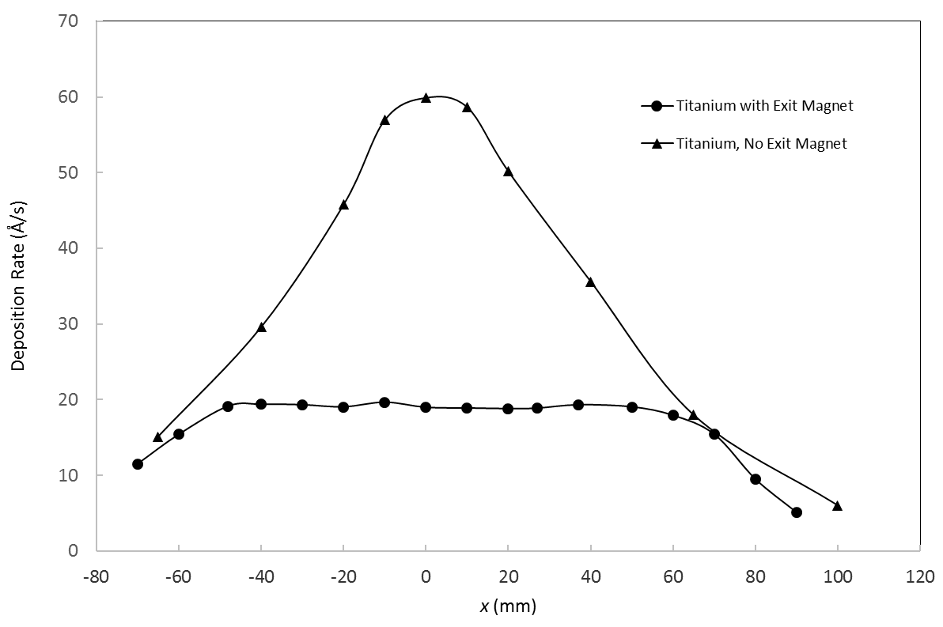
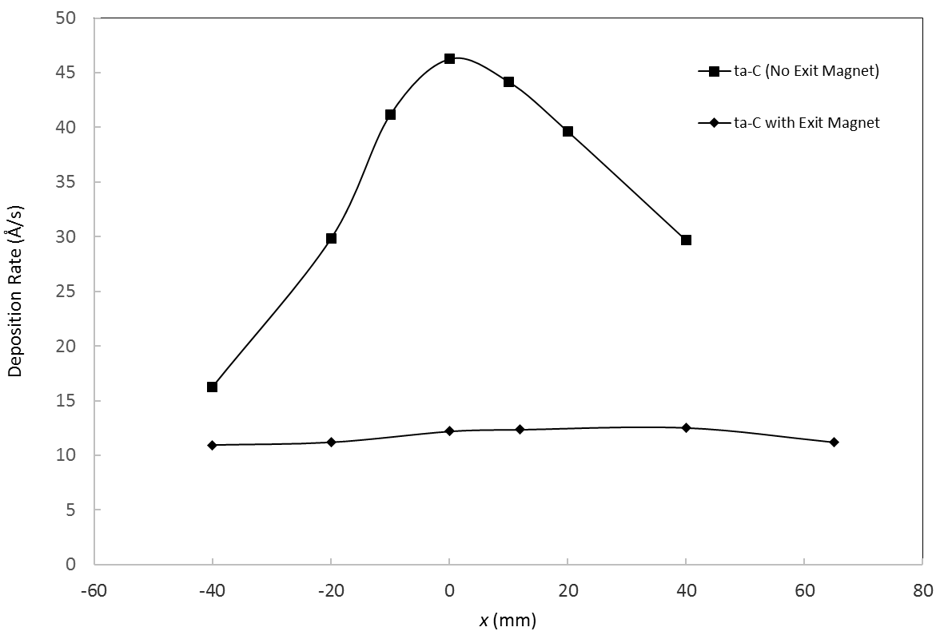
Titanium and ta-C Rate Distributions
60Å/s for titanium and 46Å/s for ta-C (260mm to substrate, 140A)
Stationary uniformity over 110mm with Exit Magnet
Titanium
ta-C

Slide 12
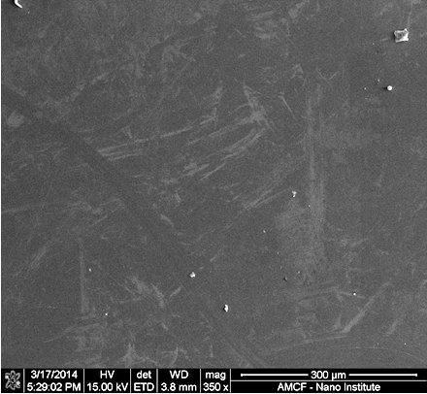
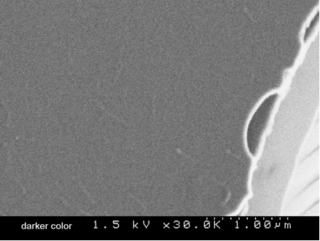
ta-C Surface Images (SEM)
8 minutes, 140A

Slide 13
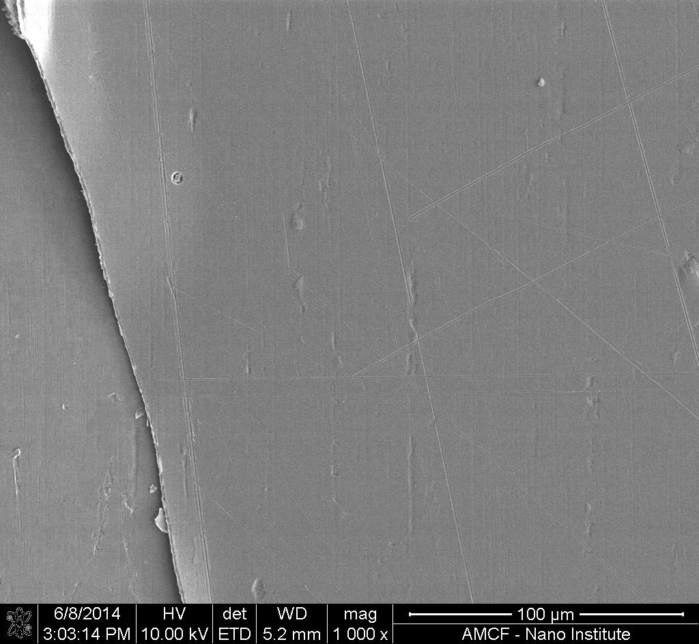
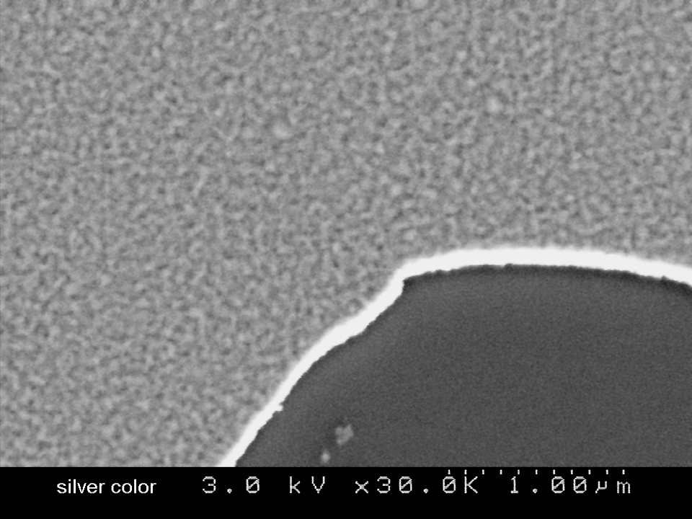
Titanium Surface Images (SEM)
10 minutes, 140A

Slide 14
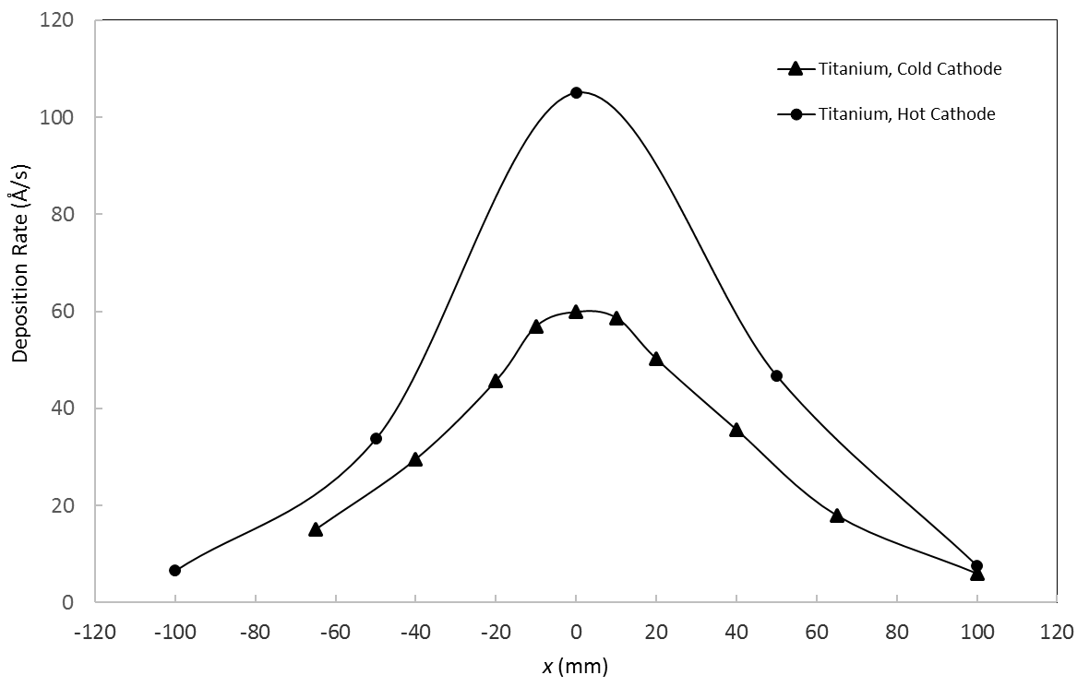
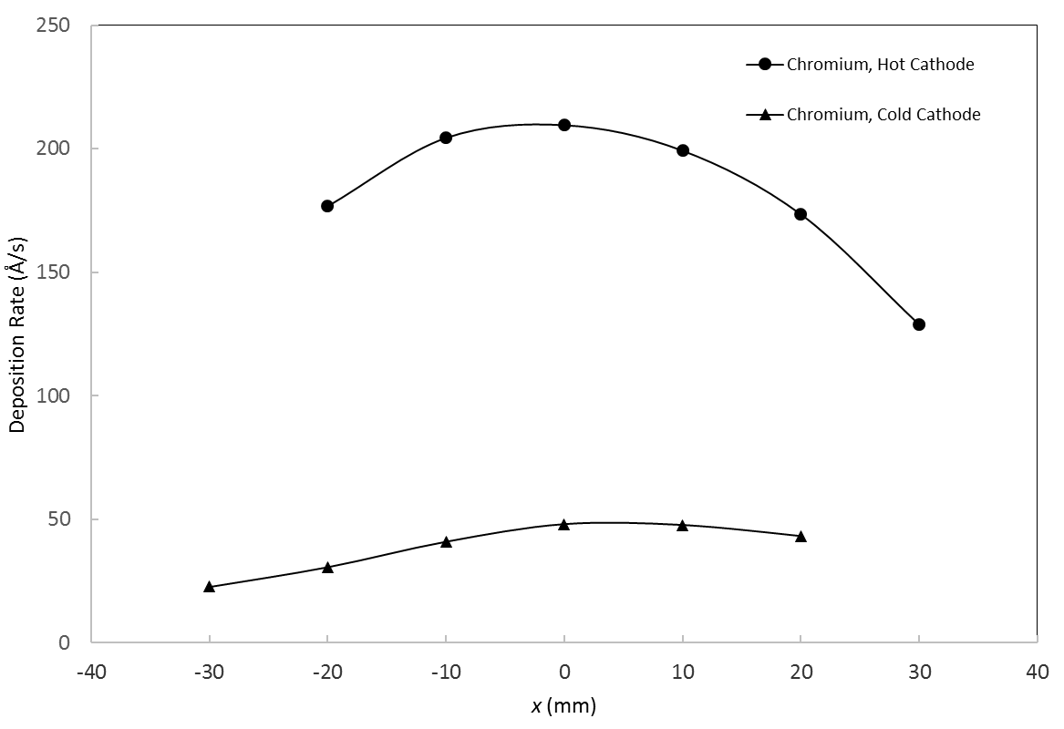
Titanium and Chromium Hot Cathode Rate Distributions
Titanium increased 1.8 times to 106Å/s
Chromium increased 3.6 times to 208Å/s
Titanium
Chromium

Slide 15
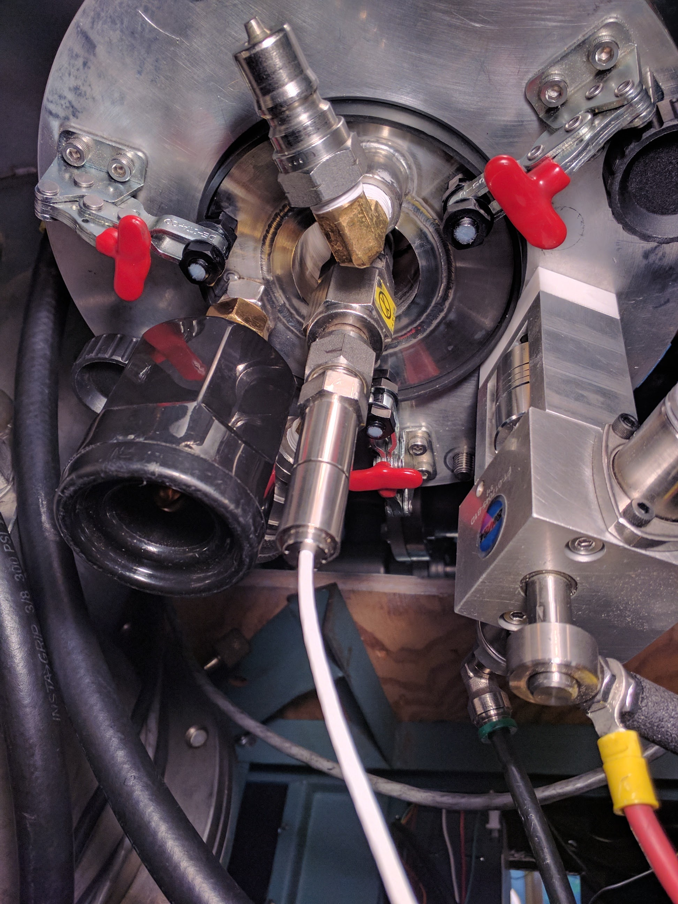
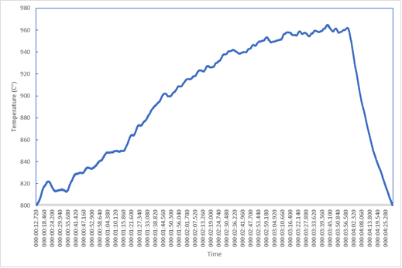
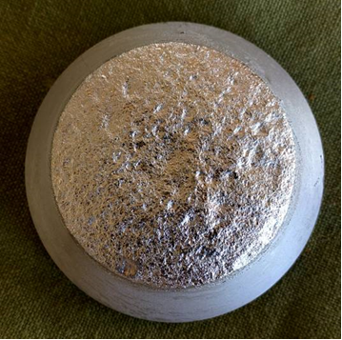
IR Sensor Monitored Cathode Temperature
Reduced Thermal conduction between Cathode and Plate
4 minutes to reach temperature
Cr plasma visible emission became bluer and less flickering
Only top of Cathode has melted appearance
A.I. Vasin et al. Sov. Tech. Phys. Lett. 5, 634-636, (1979)

Slide 16
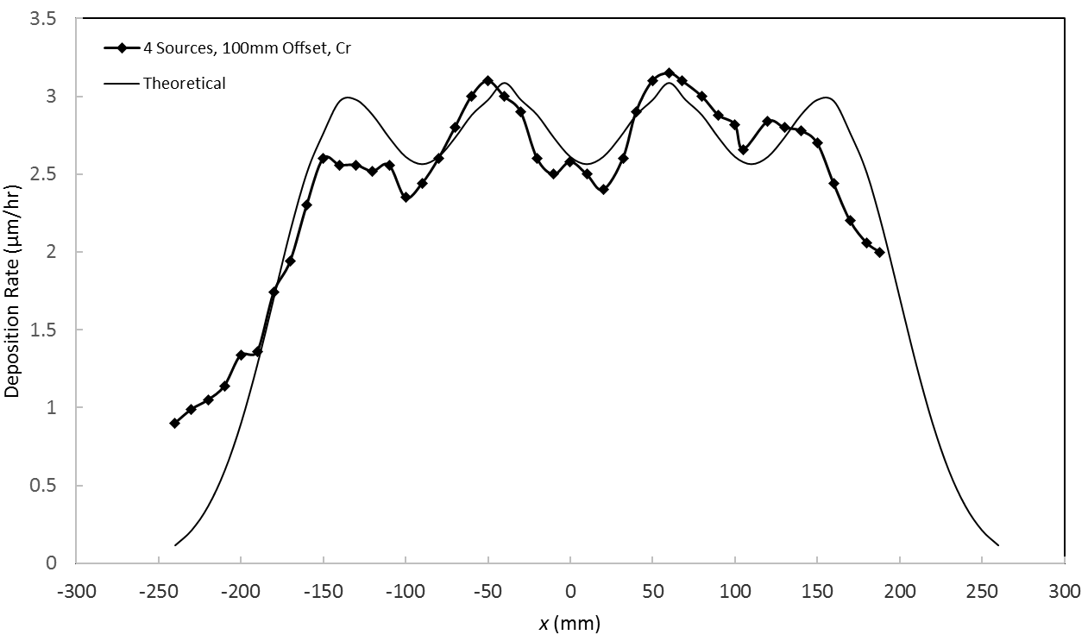
Rate Distribution in Industrial Coater from 4 Sources
100mm helical offset around a 1 meter chamber
650mm diameter rotating substrate (cylinder)
Chromium hot cathode at 180A

Slide 17
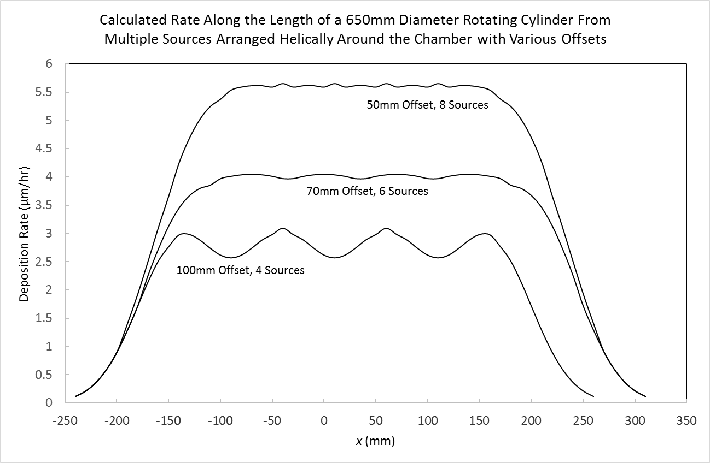
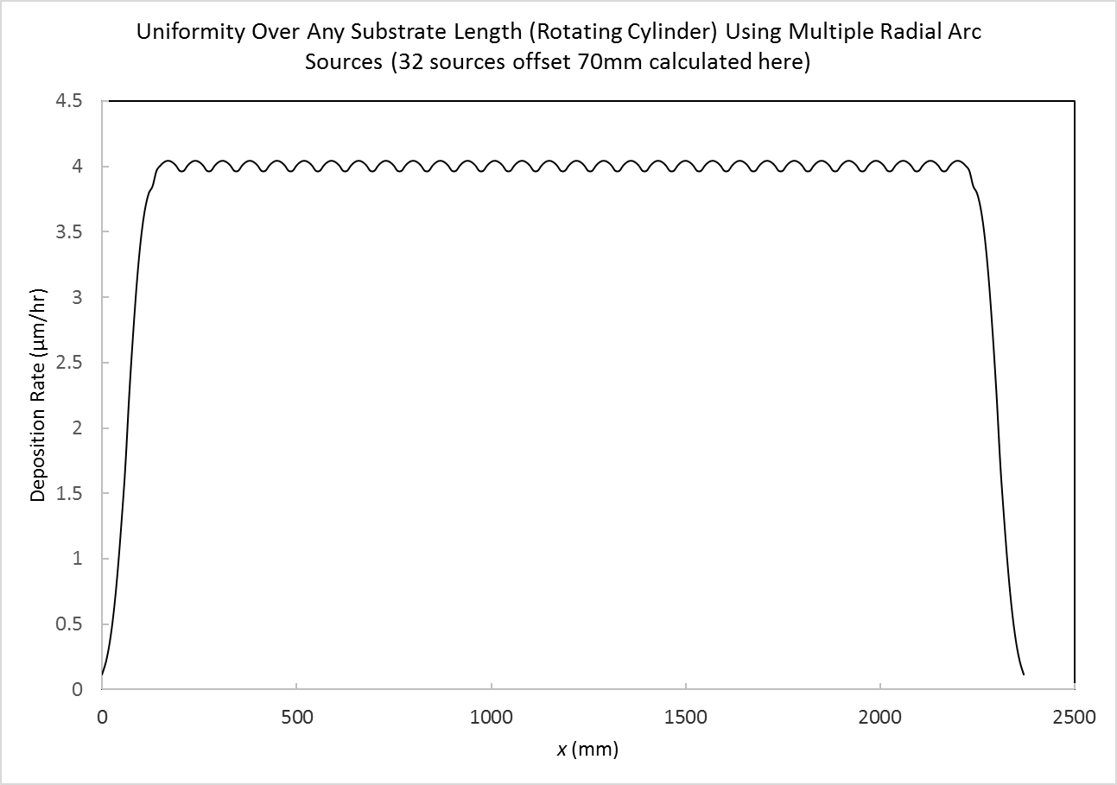
Industrial Coater Theoretical Rate Distributions with Various Offsets
70mm Offset Improves Theoretical Uniformity to 3%
Uniformity Over Any Length (2m) by Adding Sources

Slide 18
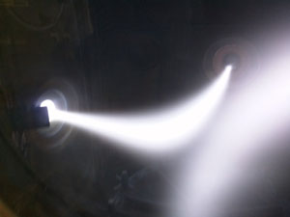
Linking Up Of The Plasma Along Magnet Field Lines Across The Vacuum Chamber

Slide 19
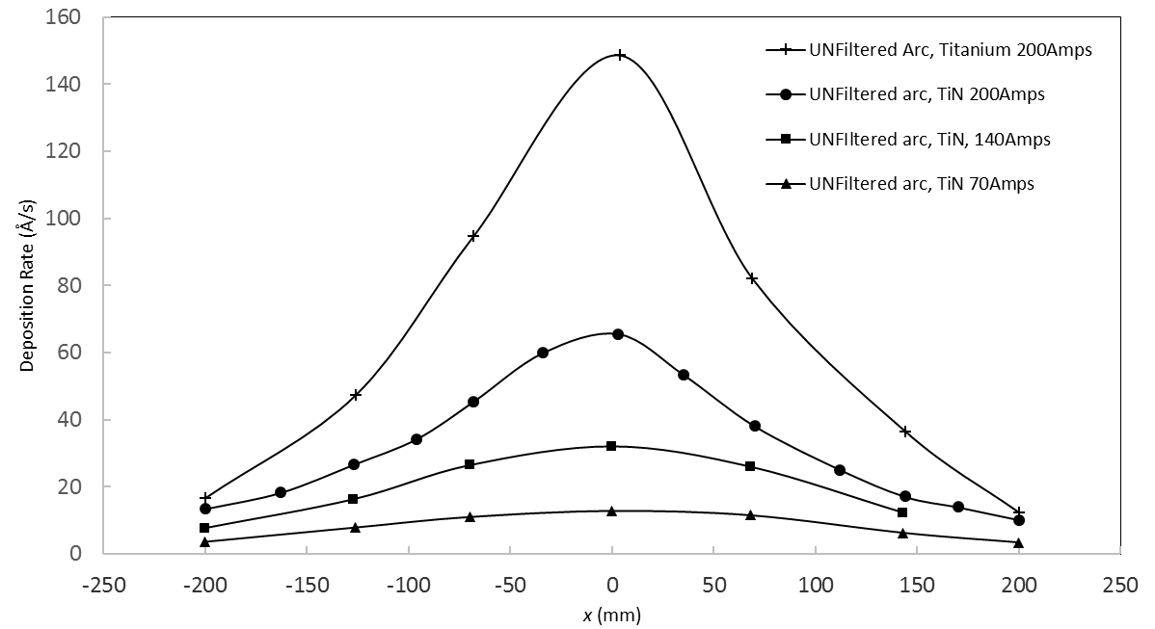
Unfiltered Arc Rate Distributions
An equivalent unfiltered arc source was substituted onto the same experimental setup to directly compare rates and estimate ion transport efficiency.

Slide 20
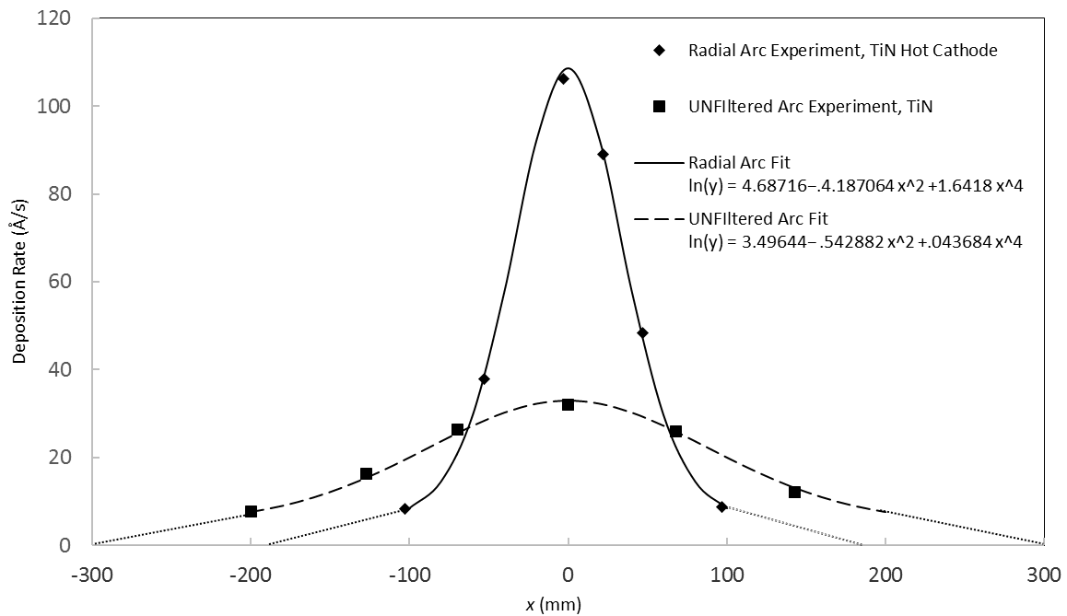
Radial Arc and Unfiltered Arc TiN Rate Distributions at 140A
The volume of the Radial Arc coating was 70% of the unfiltered arc coating
  1mTorr vs 6mTorr nitrogen for stoichiometric TiN – gas ionized in Radial Arc

Slide 21
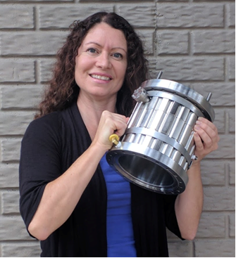
The Radial Arc is Compact and Simple
Can be quickly mounted by one person, connected to a DC welder and triggered on, like unfiltered arc
An easy replacement for other types of sources
A wide range of applications are facilitated: from single source R&D to large commercial coating systems
Uniformity on large substrates is provided for, like a linear-type source, but with more flexibility

Slide 22
Summary, Radial Arc
Compact and simple (all permanent magnets)
48, 108 and 206 Å/s for ta-C, titanium, and chromium
Hot cathode increased rate significantly
Few macroparticles apparent in the coatings
Uniformity on stationary substrates with Exit Magnet
3µm/hr in 1m commercial coater on a rotating substrate from multiple Radial Arc sources
TiN coating volume from the Radial Arc source = 70% of unfiltered arc at the same arc current
Paul Sathrum
paul@fluxion-inc.com

